Slide 1
Software Processes & REQUIREMENTS
4 June 2018

Slide 2
AGENDA
Part I - Software Processes
Part II - Requirements
Project Kickoff
Q & A
Group selection
First Project Assignment

Slide 3
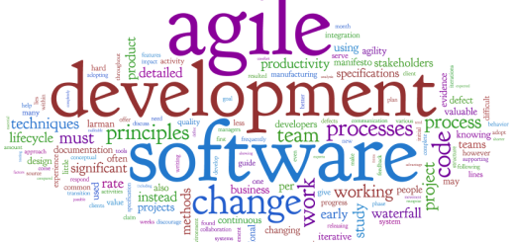
PART I – Software Processes

Slide 4
Development Models
Cowboy Coding / Code-and-fix
Ad-hoc, not well-defined
Focuses on what, not how
Waterfall
Sequential, doesn’t capture evolutionary/iterative nature of software
Spiral
Heavily relies on risk assessment
Iterative
Incremental, but constant changes may erode system architecture
Agile
Iterative approach focusing on code not design

Slide 5
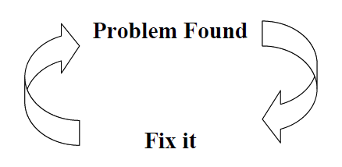
Development Models: Cowboy Coding

Slide 6
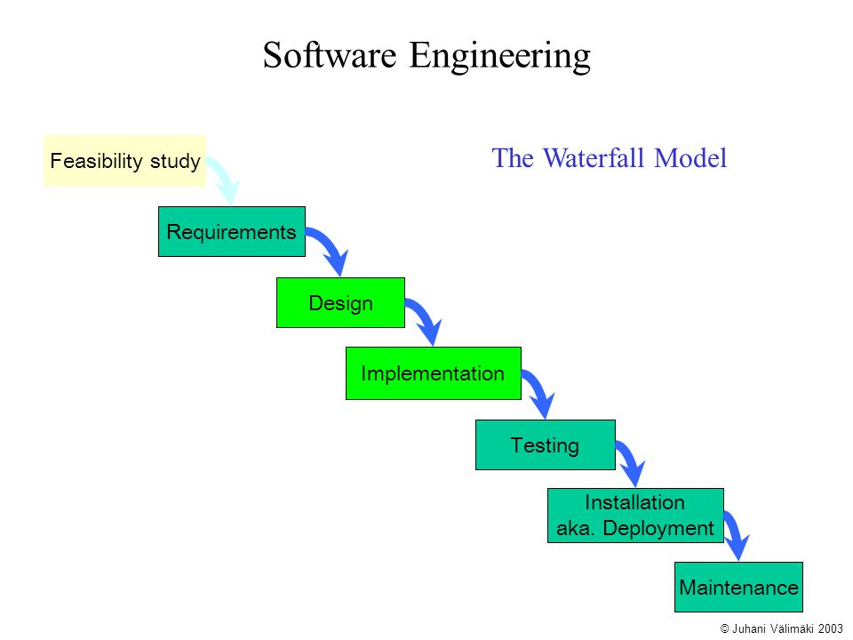
Development Models: Waterfall Model

Slide 7
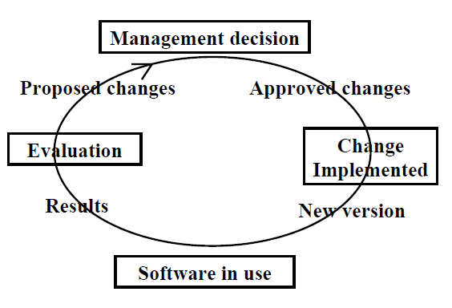
Development Models: Spiral Model

Slide 8
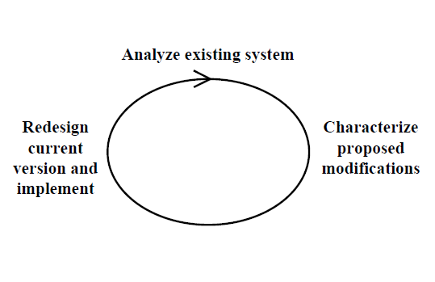
Development Models: Iterative Enhancement Model

Slide 9
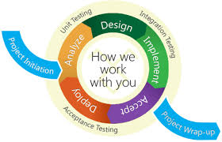
Development Models: Agile

Slide 10
The Software Process
Structured set of activities
Required to develop software system
MANY different software processes
All involve:
Specification: what system should do
Design & implementation: defining organization & creating system
Validation: Does system do what it is supposed to do?
Deployment: “Give” system to end-user
Evolution: Changing system in response to customer needs.

Slide 11
Generic Software Process Models (1 of 2)
Waterfall model
Separate, distinct phases of specification and development
Plan-driven & rigid
Evolutionary Development
Final system “evolves” by working with clients to refine initial outline of specifications

Slide 12
Generic Software Process Models (2 of 2)
Incremental Development
Specification, development and validation are interleaved
Component-based software engineering
Reuse-oriented software engineering
System built from existing components
In practice
Usually some hybrid or combination of these models

Slide 13
Concept of Process Iteration
System requirements ALWAYS change during course of project
Process iteration
Earlier stages reworked
Always part of process for large systems
Iteration can be applied to any generic process models
Two (related) approaches
Incremental delivery
Spiral development

Slide 14
Waterfall Model Phases
Separate identified phases:
Requirements analysis & definition
System & software design
Implementation &unit testing
Integration & system testing
Operation & maintenance
Major flaw
Difficulty in accommodating change after process is underway.
Theoretically → phase must be completed before moving to next phase.

Slide 15
Waterfall Model

Slide 16
Pros/Cons of Waterfall Model
Inflexible partitioning of project into distinct stages
Difficult to respond to customer changes
Appropriate when:
Requirements well-understood
Changes fairly limited during design process
Note: Few business systems have stable requirements
Mostly used for large systems engineering projects
System developed at several sites
Plan-driven nature helps coordinate work

Slide 17
Evolutionary Development
Develop Initial cut, get client feedback, refine system and repeat until system is adequate
Two Main Types:
Exploratory development
Objective
Work with client to explore reqs & deliver system
Begin with development on well-defined parts
Evolve system with new features from client
Throw-away prototyping
Objective
Start with poorly understood reqs to clarify what is really needed

Slide 18
Evolutionary Development

Slide 19
Problems with Evolutionary Development
Problems
Lack of process visibility
Systems often poorly structured
Special skills (i.e. specific languages for rapid prototyping) may be required.
Documentation can be challenging (not cost effective)
Applicability
For small or medium-size interactive systems;
For parts of large systems (e.g. the user interface)
For short-lifetime systems

Slide 20
Evolutionary Development Benefits
Cost of accommodating changes goes down
Amount of analysis & documentation that must be redone is much less than is required with waterfall model.
Quicker feedback from client on development work
Customers can comment on demonstrations of software
Can see how much has been implemented
More rapid delivery & deployment of useful software to customer is possible
Customers able to use and gain value from software sooner than with waterfall process

Slide 21
Incremental Development

Slide 22
Incremental Delivery
System not delivered in single delivery
Development & delivery broken down into increments
Each increment delivering part of required functionality
User requirements
prioritized → highest priority requirements included in early increments.
Once development of increment is started
Requirements frozen BUT requirements for later increments can continue to evolve.

Slide 23
Incremental Development Advantages
Customer value can be delivered with each increment so system functionality is available earlier.
Early increments act as prototype to help elicit requirements for later increments.
Lower risk of overall project failure.
Highest priority system services tend to receive the most testing.
Why? Done sooner

Slide 24
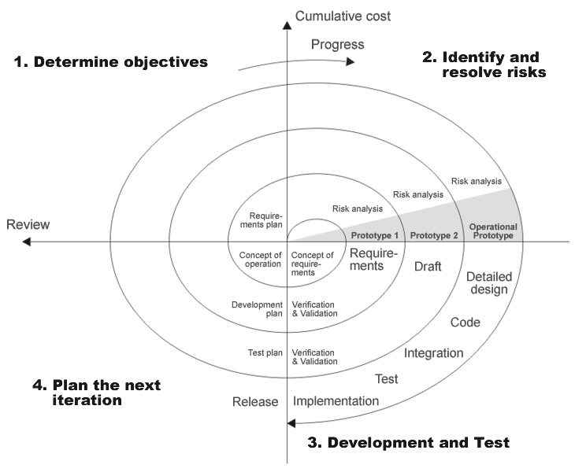
Spiral Model

Slide 25
Spiral Model Sectors
Determine objectives
Specific objectives for phase are identified.
Identify & Resolve risks
Risks are assessed
Activities put in place to reduce key risks
Development and Test
Design, Code, Integrate and Test
Plan next iteration
Project reviewed and next phase of spiral is planned.

Slide 26
Spiral Development
Process represented as spiral instead of sequence of activities with backtracking
Each loop in spiral represents phase in process
No fixed phases such as specification or design
Loops in spiral chosen depending on what is required
Risks explicitly assessed and resolved throughout the process

Slide 27
Component-Based Software Engineering
Based on systematic reuse
Aim to reduce cost and improve quality by using selected components
Systems integrated from existing components
Process stages
Component analysis
Requirements modification
System design with reuse
Development and integration
Approach being used more as component standards have emerged

Slide 28
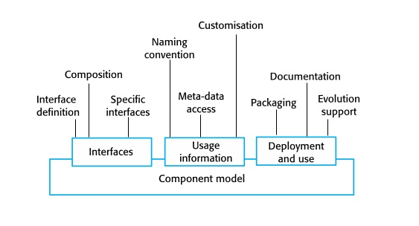
Component-Based Software Engineering

Slide 29
Main Points
Software processes: activities involved in producing and evolving a software system.
Software process models: abstract representations of these processes.
General activities: specification, design/implementation, validation and evolution.
Generic process models: describe organization of software processes.
Iterative process models describe the software process as a cycle of activities.

Slide 30
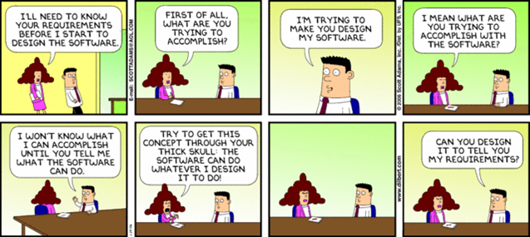
PART II - Requirements

Slide 31
Background & Terminology
Requirements
Descriptions of system services and constraints
Generated during requirements engineering process
Requirements Engineering:
Process of establishing what client needs from software
Includes constraints under which system operates and is developed

Slide 32
Requirements
Range from:
High-level abstract statements to system constraints to detailed mathematical functional specifications
Should be:
Clear
Correct
Consistent
Coherent
Comprehensible
Modifiable
Verifiable
Prioritized
Unambiguous
Traceable
Credible source

Slide 33
Types of Requirements - Functional
Relate to how system should function
Inputs system should accept
Outputs system should produce
Search options needed
Any data system must store
Computations system should perform
Timing and synchronization of above
Depend on:
Type of software
Expected users
Type of system where software is used
May be high-level statements of what system should do
Should describe system services in detail

Slide 34
Examples of Functional Requirements
“The user shall be able to perform a keyword search on all articles or filter search results by any combination of publishing date, author, title or publishing company.”
“The system shall provide downloadable pdf reports.”
“Every transaction shall be allocated a unique identifier.”

Slide 35
Types of Requirements - Non-Functional Requirements
Non-functional requirements are important
Implicit; not met→ system useless
May be very difficult to state precisely (especially early on)
Imprecise requirements may be difficult to verify
AKA: quality requirements, quality of service, or extra-functional requirements

Slide 36
Non-Functional Requirements (continued)
Design constraints: Categories constraining environment and technology of system.
Platform (minimal requirements, OS, devices…)
Technology to be used (language, DB, …)
Commercial constraints: Categories constraining project plan and development methods
Development process (methodology) to be used
Cost and delivery date
Often put in contract or project plan instead

Slide 37
Examples of Non-Functional Requirements

Slide 38
Examples of Non-Functional Requirements
Process requirement
“The system development process and deliverable documents shall conform to the standards defined in Control Document XYZ.”
Security requirement
“The system shall not disclose any sensitive, personal information about patients to any user besides the patient themselves.”

Slide 39
Examples of Non-Functional Requirements
Property
Measure
Speed
Processed transactions/second
User/Event response time
Screen refresh time
Size
K Bytes
Number of RAM chips
Ease of use
Training time
Number of help frames
Reliability
Mean time to failure
Probability of unavailability
Rate of failure occurrence
Availability
Robustness
Time to restart after failure
Percentage of events causing failure
Probability of data corruption on failure
Portability
Percentage of target dependent statements
Number of target systems

Slide 40
Requirements Engineering Processes
Processes used:
Vary depending on application domain, people involved and organization developing requirements
Generic activities common to all processes:
Requirements elicitation
Requirements analysis
Requirements validation
Requirements management

Slide 41
Requirements Engineering Process

Slide 42
Feasibility Studies
Feasibility study
Is proposed system worthwhile and doable?
Short focused study
Checks…
System contributes to organizational objectives
System can be engineered using current technology and within budget
System can be integrated with other systems used

Slide 43
Elicitation and Analysis
Sometimes called “requirements elicitation” or “requirements discovery”
Technical staff and customers collaborate
Discuss application domain
Services system should provide
System’s operational constraints
May involve end-users, managers, engineers involved in maintenance, domain experts, trade unions, etc.
All parties with vested interested in proposed system are called stakeholders.

Slide 44
Requirements Analysis – Potential Problems
Stakeholders don’t know what they want
Stakeholders express requirements in own terms
Different stakeholders have conflicting requirements
Influence of organizational and political factors
Requirements change during analysis process
New stakeholders may emerge
Business environment changes

Slide 45
The Requirements Spiral

Slide 46
Requirements Engineering Process Activities
Discovery
Interacting with stakeholders to discover their requirements.
Classification & Organization
Group related requirements
Organize into coherent clusters
Prioritization & Negotiation
Prioritizing requirements
Resolving requirements conflicts
Requirements documentation
Requirements documented and input into next round of spiral.

Slide 47
Requirements Discovery
Process of gathering information
Proposed and existing systems
Distilling user and system requirements from this information
Sources of information:
Documentation
System stakeholders
Specifications of similar systems

Slide 48
Requirements Elicitation - Interviewing
Formal or informal interviewing
Stakeholders questioned about:
System they use
System to be developed
Two types of interviews
Closed interviews
Pre-defined set of questions are answered
Open interviews
No pre-defined agenda
Range of issues are explored with stakeholders

Slide 49
Interviews in Practice
Mix of closed and open-ended interviewing
Good for getting overall understanding of:
What stakeholders do
How they might interact with system
Not good for understanding domain requirements
Engineers likely don’t understand specific domain terminology
i.e. Air Traffic Control
Some domain knowledge is so familiar that people find it hard to articulate or think that it isn’t worth articulating.

Slide 50
Tips for Effective Interviews
Interviewers should:
Be open-minded
Be willing to listen to stakeholders
NOT have pre-conceived ideas about requirements or a solution
Avoid jumping to conclusions!
Prompt or Lead interviewee with question or idea
Don’t expect them to respond to something like “what do you want” or “how do you want the website to work”?

Slide 51
Requirements validation
Demonstrate that requirements define system that customer really wants.
Requirements error costs are high so validation is very important!
*** Fixing a requirements error after delivery may cost up to 100 times the cost of fixing an implementation error ***

Slide 52
Requirements checking
Validity. Does system provide functions which best support the customer’s needs?
Consistency. Are there any requirements conflicts?
Completeness. Are all functions required by customer included?
Realism. Can requirements be implemented given available budget and technology
Verifiability. Can requirements be checked?

Slide 53
Requirements validation techniques
Requirements reviews
Systematic manual analysis of requirements.
Prototyping
Using an executable model of system to check requirements
Test-case generation
Developing tests for requirements to check testability

Slide 54
Requirements reviews
Regular reviews
Held while requirement definition(s) are being formulated
Both client and contractor staff should be involved
May be formal (with completed documents) or informal.
Good communication between developers, customers and users can resolve problems at early stage.

Slide 55
Requirements Review verifies
Verifiability
Is requirement realistically testable?
Comprehensibility
Is requirement properly understood?
Traceability
Is origin of requirement clearly stated?
Adaptability
Can requirement be changed without a large impact on other requirements?

Slide 56
Requirements Management
Process of managing changing requirements during RE process and system development.
Requirements inevitably are incomplete and inconsistent
New requirements emerge during process
Business needs change
Better understanding of system is evolved
Different viewpoints have different requirements and these are often contradictory

Slide 57
Requirements Change
Priority of requirements from different viewpoints changes during development process.
System customers
Might specify requirements from business perspective that conflict with end-user requirements
Business and technical environment of system changes during development

Slide 58
Requirements Evolution

Slide 59
Requirements Management Planning
During requirements engineering process, you have to plan:
Requirements identification
How requirements are individually identified
Change management process
Process followed when analyzing requirements change
Traceability policies
Relationships between requirements, their sources and system design

Slide 60
Traceability
Traceability
Concerned with relationships between requirements, their sources and system design
Source traceability
Links from requirements to stakeholders who proposed requirements
Requirements traceability
Links between dependent requirements
Design traceability
Links from requirements to design

Slide 61
Requirements change management
Should apply to all proposed changes to requirements
Principal stages:
Problem analysis
Discuss requirements problem and propose changes
Change analysis and costing
Assess effects of change on other requirements
Change implementation
Modify requirements document and other documents to reflect change
Update requirements document in secure data store
Requirements doc should be under some type of version control to track changes

Slide 62
Change management

Slide 63
Group Selection & Deliverable #1
Tonight (6/4)
Select Groups - split into 2 groups of 3-5 people
Per Group:
Designate POC (Point of Contact)
POC: person that handles project-related communication with me
POC to email me all group members (first & last name, email) tonight
I will set up your group in blackboard before you leave!
Deliverable #1 – due 6/5/2018 COB (5 PM EST)
Requirements (first draft)
Notes:
No specific format (electronic, no hand drawings)
If you use an online template you must cite your source!
Should be compatible with Office word document
Make sure to present your requirements in clear, organized manner

Slide 64
Sources
https://en.wikipedia.org/wiki/Software_development_process
http://www.cs.ccsu.edu/~stan/classes/CS530/Slides11/Ch2.pdf
http://www.cs.ccsu.edu/~stan/classes/cs530/slides/se-04.pdf
http://www.tutorialspoint.com/software_engineering/software_requirements.htm
http://slideplayer.com/slide/3743031/
www.cs.ccsu.edu/~stan/classes/cs530/slides/se-19.pdf
http://www.bihagiledev.com/wp-content/uploads/2015/03/agilenewera-520x245.png
https://blog.inf.ed.ac.uk/sapm/2014/03/14/component-based-software-engineering-over-traditional-approaches-in-large-scale-software-development/
http://moodle.autolab.uni-pannon.hu/Mecha_tananyag/szoftverfejlesztesi_folyamatok_angol/ch03.html#d0e566
Pressman – Software Engineering

